Slide 1
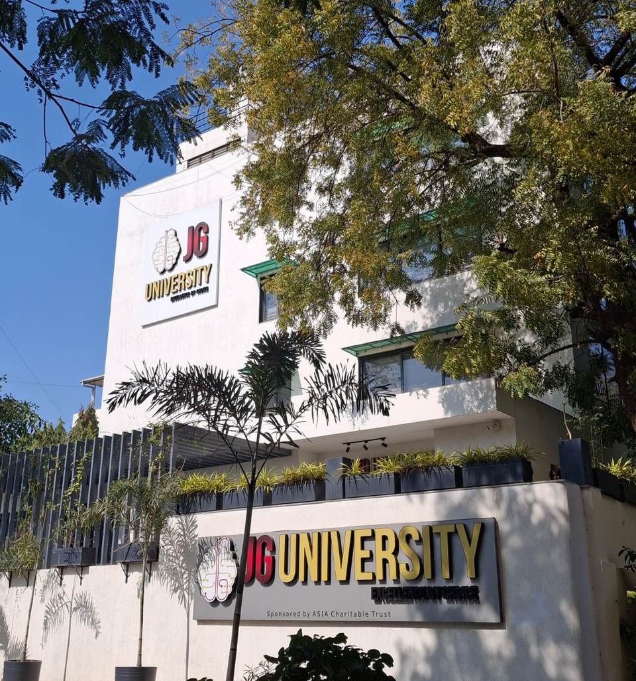


JG
UNIVERSITY
‘’Excellence By Choice’’
Get Started

Slide 2

About
UNIVERSITY
JG University is focused on enhancing campus connectivity and student experience
A centralized system to manage communication, events, and resources
Helps students and faculty stay connected and informed
Accessible through modern digital solutions

Slide 3

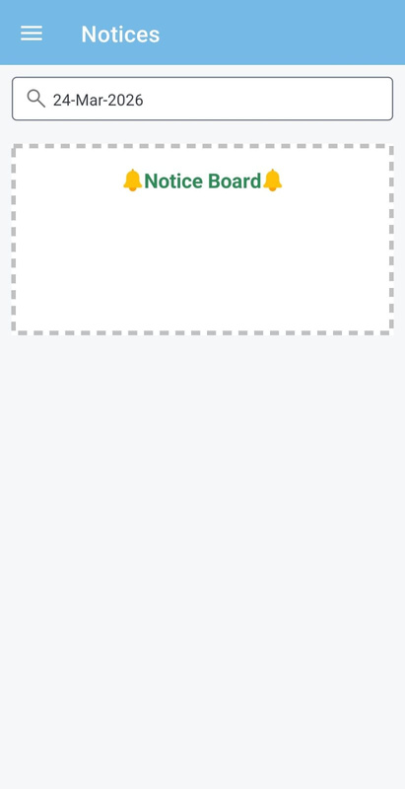
Problem Statement
Academic information is scattered across platforms like WhatsApp, email, and notice boards
Students miss important announcements, deadlines, and exam updates
No centralized system for accessing all academic information
Difficulty in accessing study materials like notes, PPTs, and resources
Confusion regarding assignments and submission deadlines
Communication gap between students and faculty
Timetable changes and schedules are not clearly communicated
Academic events are poorly organized and not properly informed

Slide 4



Academic Solutions
Provides academic announcements like exam notices, deadlines, and timetable updates
Enables easy sharing of study materials (notes, PDFs, PPTs)
Helps manage assignments with clear instructions and deadlines
Offers access to class and exam timetables in one place
Improves communication between students and faculty
Shares information about academic events like workshops and seminars
Allows students to check results and performance updates
Creates a centralized system for all academic information

Slide 5
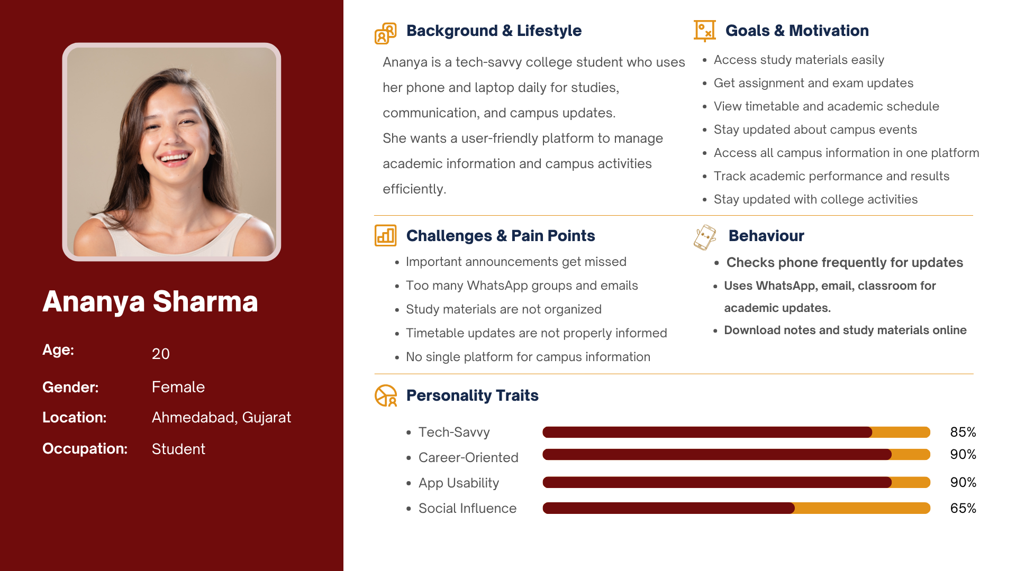
User Persona

Slide 6






User Research
Target Users:
User Needs:
Students
Faculty
Admin
Centralized campus platform
Study materials and timetable updates
Event Information
Communication system
Assignment and attendance
Simple and user-friendly
User Problems:
Design Descision:
Missing important announcements
Scattered academic information
Difficulty accessing study materials
Communication gap between students and faculty
Dashboard
Academic sections
Simple navigation
Event Section
TimeTable and attendance section
Fees history

Slide 7

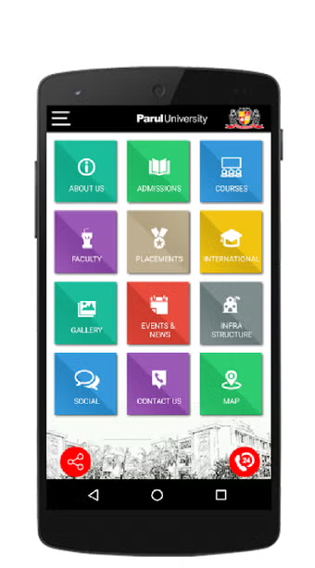

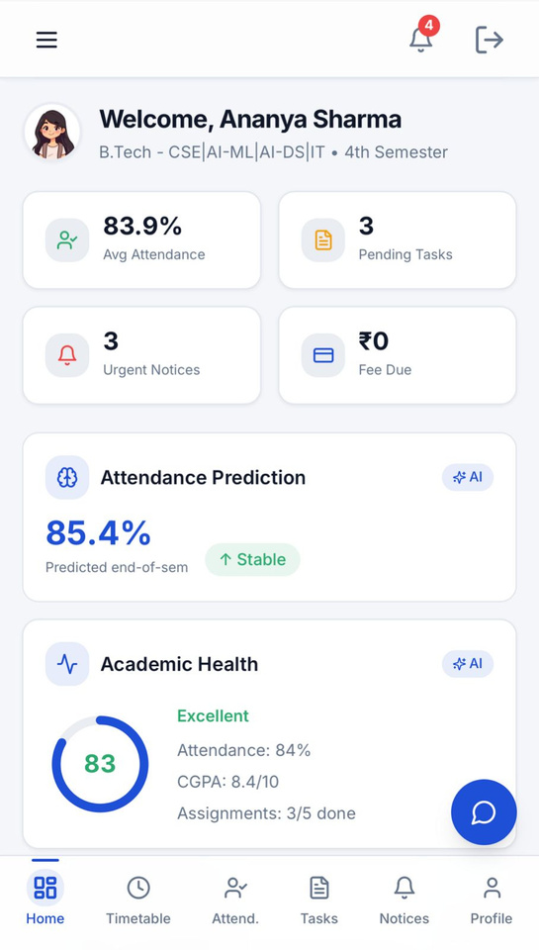
Competitor Analysis
JG University App VS Parul University App (PU Student)
Parul
Course materials & assignments access
Timetable + attendance tracking
AI-powered learning & interview prep
Communication with faculty & peers
Full ERP system (admissions, exams, performance)
Strength: Advanced + AI-based + All-in-one platform
Student profile details
Semester timetable (day-wise)
Attendance tracking (subject-wise %)
Subject & lecture information
Simple and easy UI
Strength: Simple + focused + easy to use
Weakness: Limited features
(no AI, no advanced learning tools)
Not interactive / less engaging
JG

Slide 8
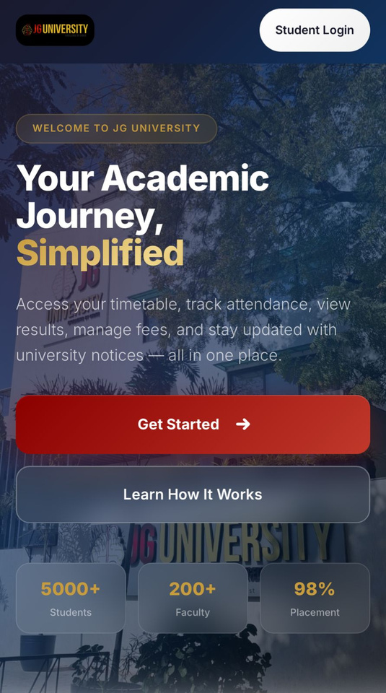
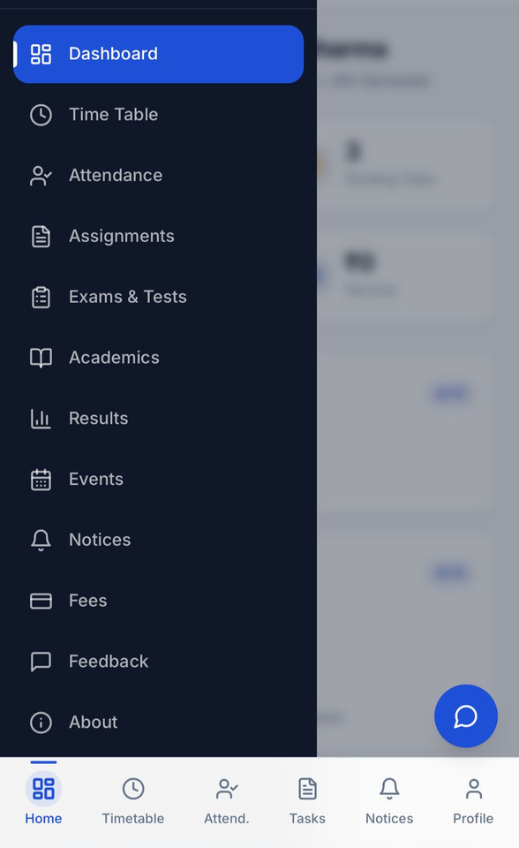
Wireframes
Login Page - Username,Password
Login Button
Profile Page - User information
and settings
Dashboard - Announcements,
Events and updates

Slide 9


Prototype
We created an interactive prototype of the JG Campus Connect website.
The prototype demonstrates the overall working and navigation of the system.
Users can navigate through different pages like Login, Dashboard, Academic, Events, Chat, and Profile.
The dashboard shows announcements, events, and important updates in one place.
The academic section contains study materials, assignments, and timetable information.
The events section shows upcoming campus events and activities.
The chat section allows communication between students and faculty.
The profile section allows users to manage their personal information.
The prototype shows the user flow and interface before actual development.
It helps in testing the design, navigation, and user experience of the system.

Slide 10

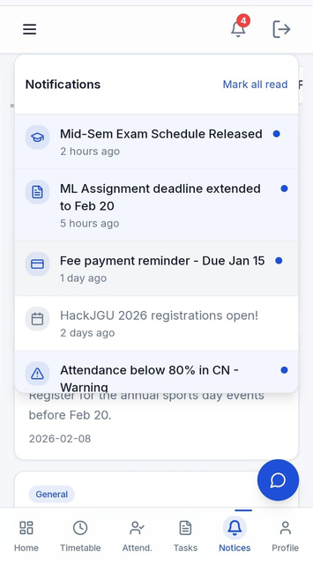
Conclusion
JG Campus Connect is a centralized campus platform for students, faculty, and administration
It solves the problem of scattered academic and campus information
The system provides academic information, announcements, events, and communication in one place
The UI/UX design focuses on simple, clean, and user-friendly interface
Wireframes and prototype were created to design and test the system
The platform improves communication, organization, and information management in the campus
It saves time and improves efficiency for students and faculty
Overall, JG Campus Connect improves campus connectivity and user experience

Slide 11
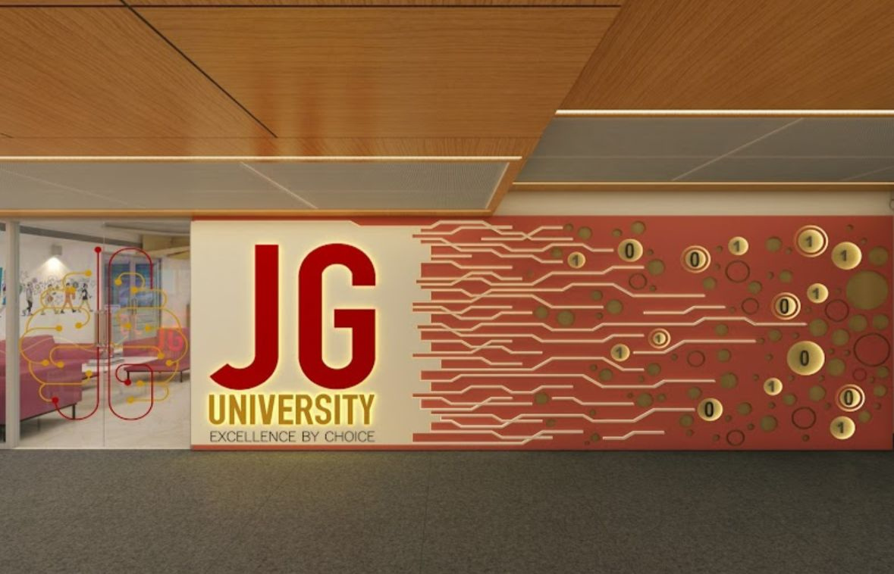
THANK YOU

